Slide 1
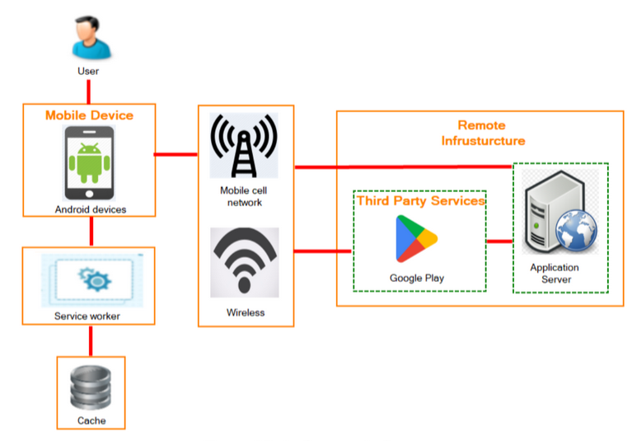

Slide 2


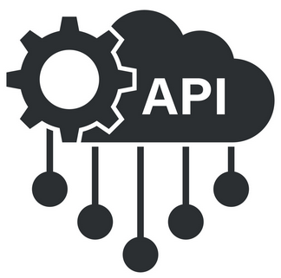







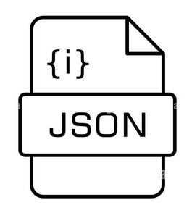
Remote Infrastructure
User
(Hosted on Lightning.AI)
Network Connectivity
Remote AI server
Mobile Device
Cellular Network
Third Party Services
FastAPI/LitServe Endpoint
Android devices
Wireless Network
iNaturalist API
Pytorch Transformer Model
Local Data Management
OSM Data
(Hosted on Lightning.ai)
Structured
Static information

Slide 3

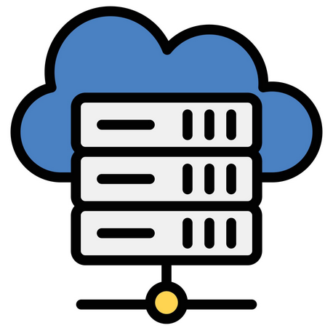

User
Internet access
(Hosted on Lightning.AI)
Internet access
Service worker

